Slide 1

Problem Statement :
To analyse world wide covid data and check which are effective measures to tackle the pandemic
Data Description:
Coronavirus disease (COVID-19) is an infectious disease caused by the SARS-CoV-2 virus.
This data set will show the data about covid-19 cases from the year 2020 to 2022 this dataset has 47 columns and 184854 rows.
This dataset contains covid related data like confirmed ,death , recovered cases , population etc.
Our aim is to analyze the covid data across the world.

Slide 2
UNDERSTANDING THE DATASET
Attributes | Description
ID | Unique identifier for the geographical entity.
Date | Observation date in the format YYYY-MM-DD
confirmed | Cumulative number of confirmed cases.
deaths | Cumulative number of deaths
recovered | Cumulative number of patients released from hospitals or reported recovered
tests | Cumulative number of tests
vaccines | Cumulative number of total doses administered.
Attributes | Description
People_ vaccinated | Cummulative number of people who received at least one vaccine dose.
People_fully _vaccinated | Cumulative number of people who received all doses prescribed by the vaccination protocol
Hosp | Number of hospitalized patients on date
icu | Number of hospitalized patients in intensive therapy on date.
Vent | Number of patients requiring invasive ventilation on date.
population | Total population

Slide 3
Attributes | Description
School_closing | 0-no measures 1-recommend closing or all schools open with alternations resulting in significant difference compared to noo-covid-19 operations 2-require closing 3-require closing all levels
Cancel_events | 0-no measures 1-recommend cancelling 2-require cancelling
Workplace _closing | 0-no measures 1- recommend closing or all businesses open with alternations resulting in significant 2- require closing (or work from home) for some sectors or categories of workers 3 - require closing for all-but-essential workplaces .
Gatherings _ restrictios | 0 - no restrictions 1 - restrictions on very large gatherings (the limit is above 1000 people) 2 - restrictions on gatherings between 101-1000 people 3 - restrictions on gatherings between 11-100 people 4 - restrictions on gatherings of 10 people or less
Attributes | Description
transport_closing | 0 - no measures 1 - recommend closing (or significantly reduce volume/route/means of transport available) 2 - require closing (or prohibit most citizens from using it)
stay_home _restrictions | 0 - no measures 1 - recommend not leaving house 2 - require not leaving house with exceptions for daily exercise, grocery shopping, and ‘essential’ trips 3 - require not leaving house with minimal exceptions (eg allowed to leave once week)
Internal _movement _restrictions | 0 - no measures 1 - recommend not to travel between regions/cities 2 - internal movement restrictions in place
International _movement _restrictions | 0 - no restrictions 1 - screening arrivals 2 - quarantine arrivals from some or all regions 3 - ban arrivals from some regions 4 - ban on all regions or total border closure
contact_tracing | 0 - no contact tracing 1 - limited contact tracing; not done for all cases 2 - comprehensive contact tracing; done for all identified cases

Slide 4
Attributes | Description
Information _campaigns | 0 - no Covid-19 public information campaign 1 - public officials urging caution about Covid-19 2- coordinated public information campaign (eg across traditional and social media)
testing_policy | 0 - no testing policy 1 - only those who both (a) have symptoms AND (b) meet specific criteria (eg key workers, admitted to hospital, came into contact with a known case, returned from overseas) 2 - testing of anyone showing Covid-19 symptoms 3 - open public testing (eg “drive through” testing available to asymptomatic people)
Elderly _people _protection | 0 - no measures 1 - Recommended isolation, hygiene, and visitor restriction measures in LTCFs and/or elderly people to stay at home 2 - Narrow restrictions for isolation, hygiene in LTCFs, some limitations on external visitors and/or restrictions protecting elderly people at home 3 - Extensive restrictions for isolation and hygiene in LTCFs, all non-essential external visitors prohibited, and/or all elderly people required to stay at home and not leave the home with minimal exceptions, and receive no external visitors
Attributes | Description
vaccination_ policy | 0 - No availability 1 - Availability for ONE of following: key workers/ clinically vulnerable groups (non elderly) / elderly groups 2 - Availability for TWO of following: key workers/ clinically vulnerable groups (non elderly) / elderly groups 3 - Availability for ALL of following: key workers/ clinically vulnerable groups (non elderly) / elderly groups 4 - Availability for all three plus partial additional availability (select broad groups/ages) 5 - Universal availability
facial_coverings | 0 - No policy 1 - Recommended 2 - Required in some specified shared/public spaces outside the home with other people present, or some situations when social distancing not possible 3 - Required in all shared/public spaces outside the home with other people present or all situations when social distancing not possible 4 - Required outside the home at all times regardless of location or presence of other people

Slide 5
Attributes | Description
government_response _index | The index records how the response of governments has varied over all indicators in the becoming stronger or weaker over the course of the outbreak.
Stringency _index | The index records the strictness of ‘lockdown style’ policies that primarily restrict people’s behaviour.
containmnt_health _index | The index combines ‘lockdown’ restrictions and closures with measures such as testing policy and contact tracing, short term investment in healthcare, as well investments in vaccines.
ATTRIBUTS | DESCRIPTION
economic_support _index | The index records measures such as income support and debt relief.
Administrative_ area _level | Level of the administrative area: 1 for countries; 2 for states, regions, cantons, or local equivalent; 3 for cities, municipalities, or local equivalent.
Administrative _area_level_1 | Name of the administrative area of level 1.

Slide 6
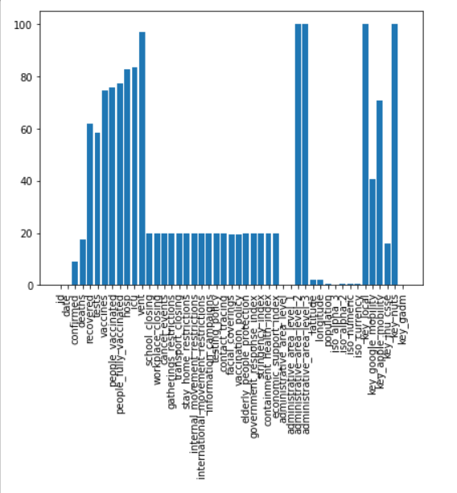
DATA PRE-PROCESSING
Total number of entries in dataset : 8688138
Total number of null entries: 2822270 (32.48%)
Percentage of NULL values in each attributes:
Deleting attributes which is completely null and are irrelevant to analysis
Some of the attributes are 100% null .
And some of the attributes are not important and does not affect our analysis.
These attributes need to be dropped.
Percentage of null values in dataset after deleting these attributes is : 28.48%

Slide 7
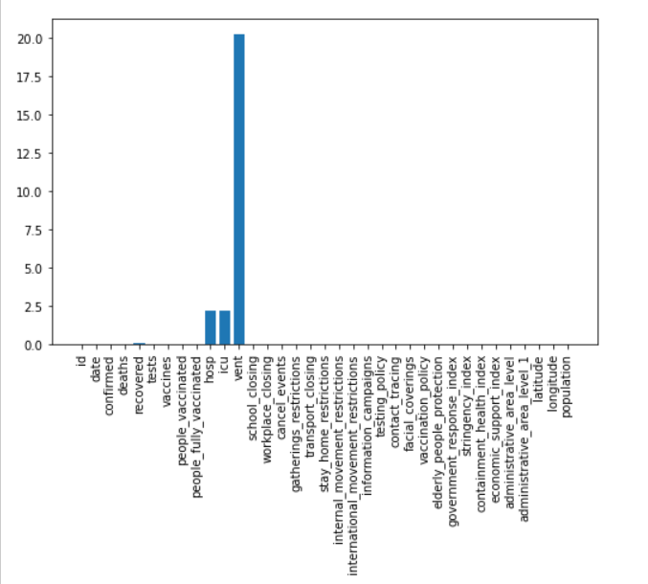
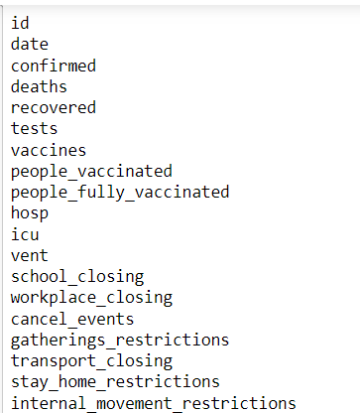
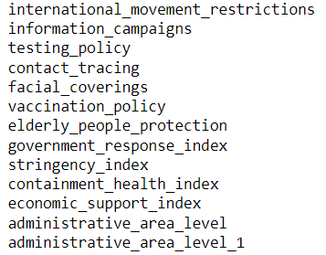
Null values are filled by bfill and pad method as number of cases arrived ,deaths etc in covid data depends on previous days statistics
At the end of pre-processing :
Percentage of Null values is 0.
Since there are no rows with completely null values , number of rows remain same i.e, 184854.
As there were few columns with completely null values and few irrelevant columns after deleting them , number of columns is 33 and those are:
Percentage of NULL values in each attributes after using bfill method
Remaining null values are handled by using pad method , after this process percentage of null values in data set is 0%

Slide 8
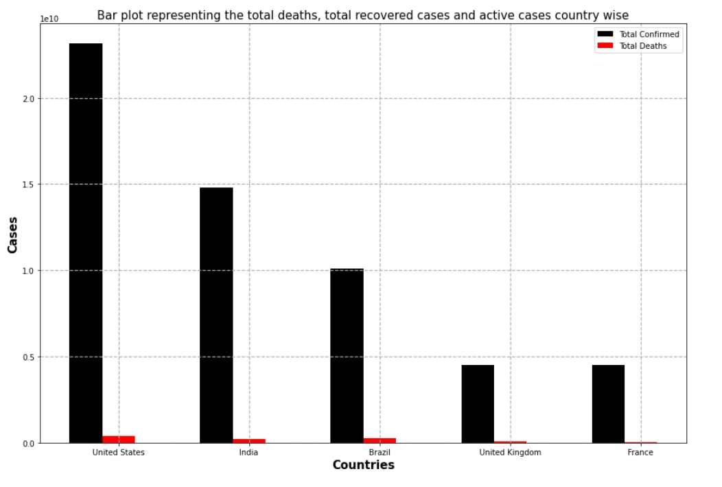
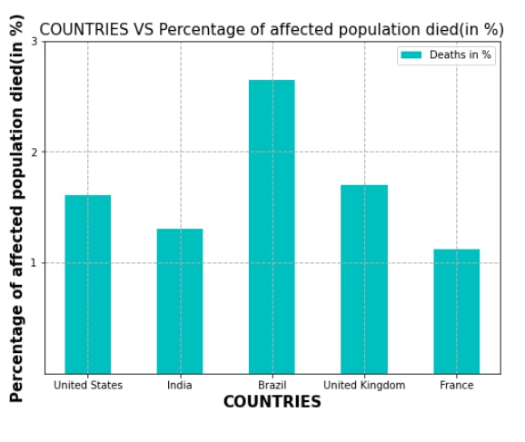
Now let us consider top 5 countries with highest number of confirmed cases to analyze the data:
Graph between cases and countries:
Graph Between death rate and countries:
United States has more number of positively tested cases then India ,Brazil , United Kingdom and France respectively.
Even though Brazil has less cases compared to other countries but has more death rate.
Also India has more number of cases but it has less death rate.

Slide 9
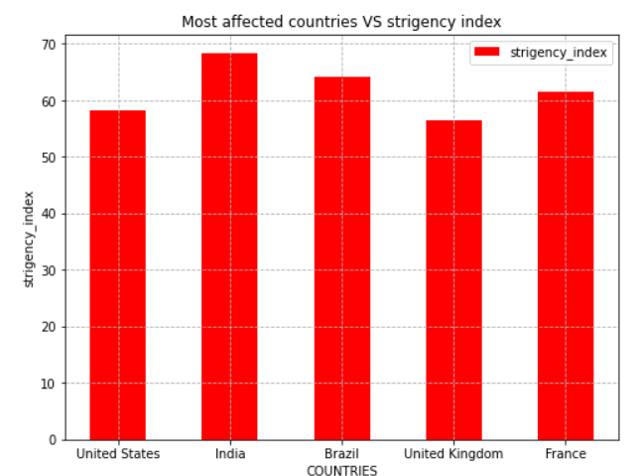
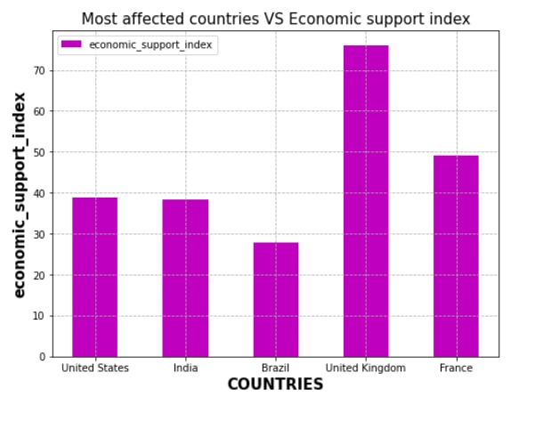
Graph between stringency_index Vs countries:
Graph between Economic_support_index
Vs countries:
From this bar graph we can say that India has more strictness of lockdown so percentage of people affected is low.
Also comparatively United Kingdom have less strictness of lockdown style therefore more number of people are affected .
United Kingdom has received more income support from other countries.
Brazil has received less income support on comparing with other countries could be the reason it lacked behind in tackling covid.

Slide 10
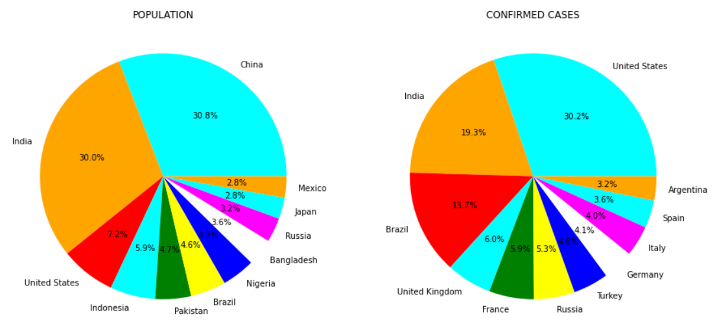
Comparison of population and confirmed cases :
By seeing the above two pie chart we can conclude that although China stands first in population but it is not present in top 10 affected countries.
Although India has very high population compared to USA but still it has death less confirmed cases compared to USA.
Find the reasons for the above hypothesis that CHINA,INDIA have managed the pandemic compared to USA

Slide 11
Effective measures taken by the government like -
1) School closing
2) Workplace closing
3) Cancel events
4) Transport closing
5) Stay home restrictions
6) Internal movement restrictions
7) International movement restrictions
8) Information campaigns
Whether these measures are effective to control spread of covid cases?
Now let us consider the above measures and compare CHINA ,INDIA and USA , and let us analyse what measures taken by India and China have not been taken by USA.
Also check whether on implementing all these measures will there be any effect on infection rate?

Slide 12
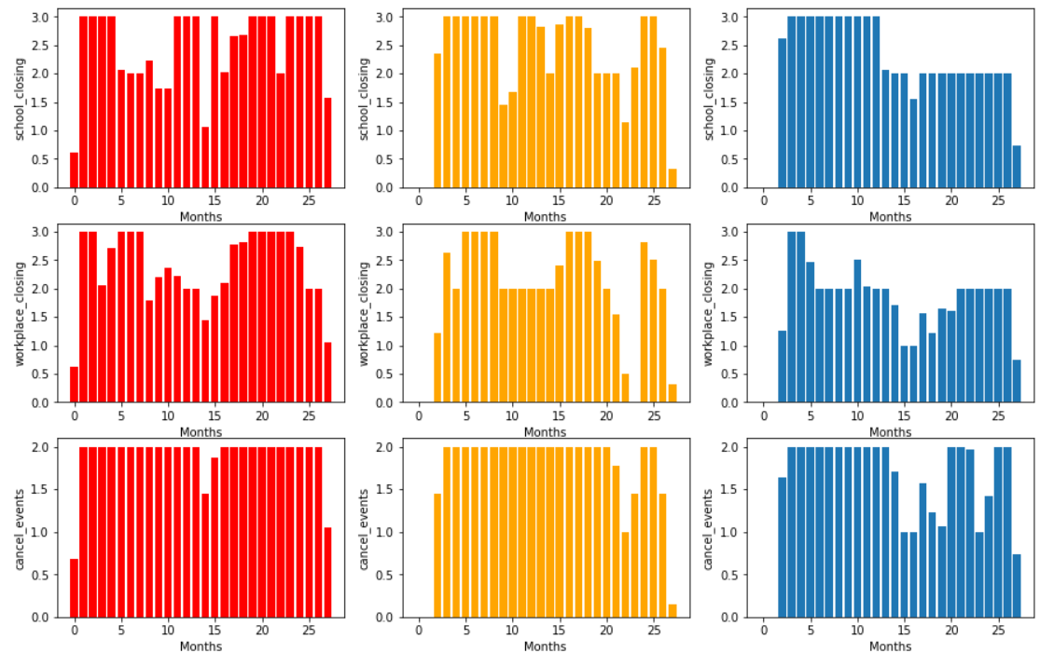
Comparing the measures taken by three countries
From the above plot we can see that China has implemented these lockdown measures strictly compared to India and USA.

Slide 13
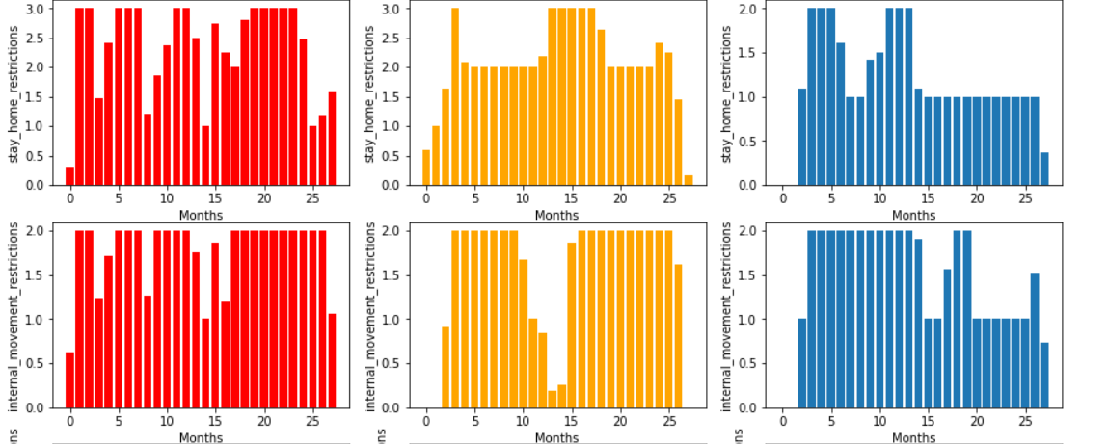
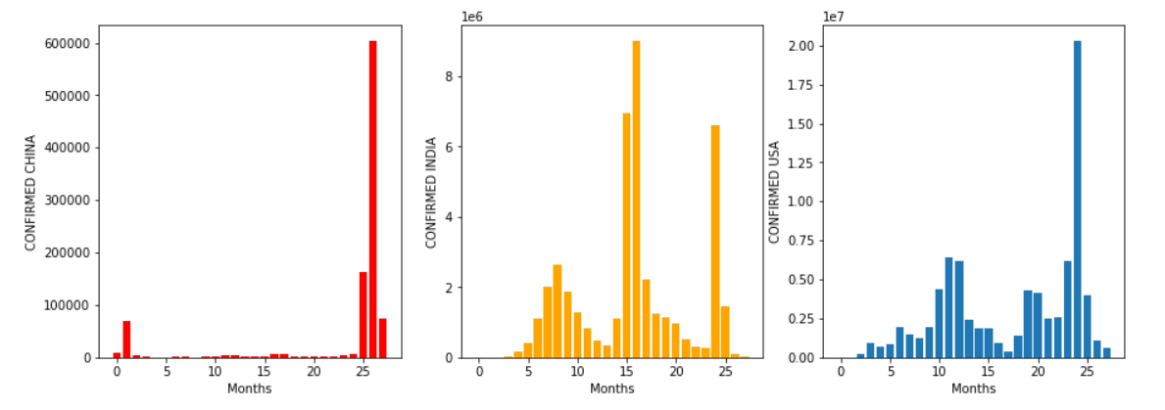
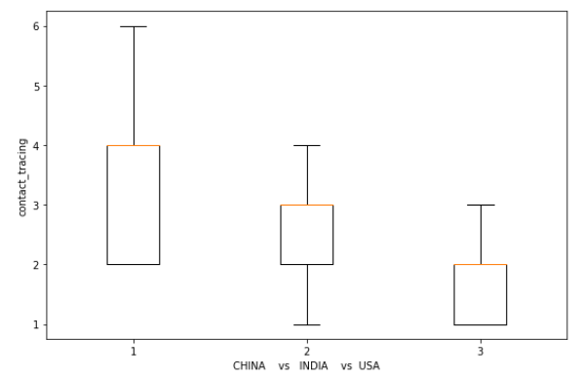
By this we can conclude that the country which implemented these measures effectively have got control over confirmed cases

Slide 14
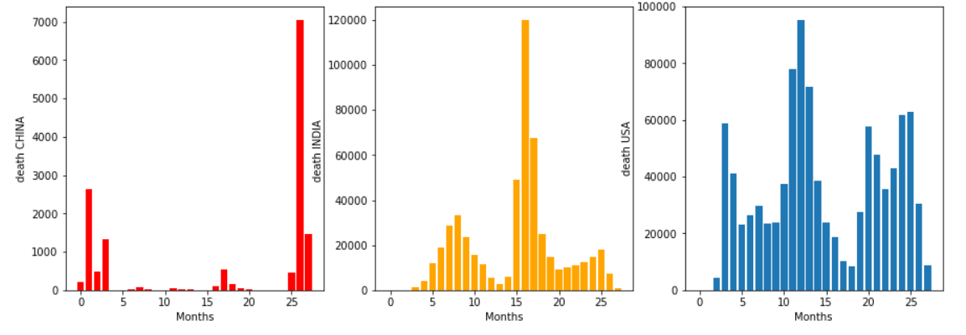
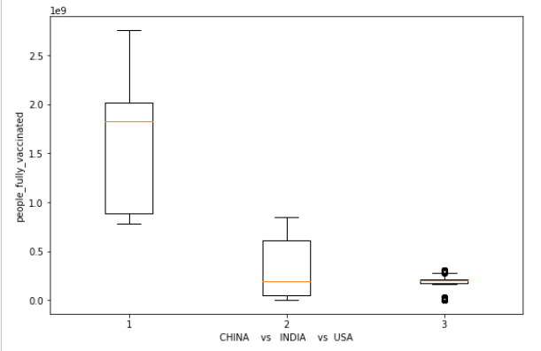
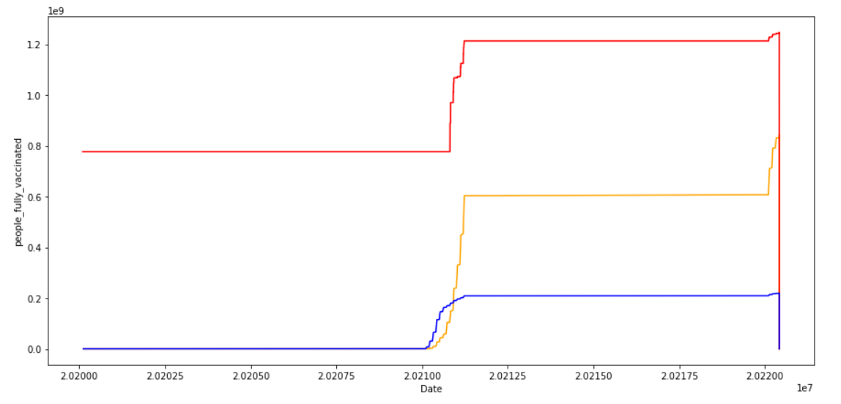
What are the measure to control death rate ?
By seeing the above plots we can understand that
On increasing the vaccination rate we an control the death rate.

Slide 15
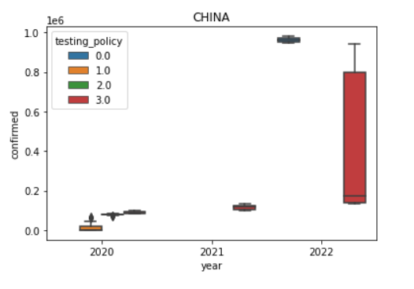
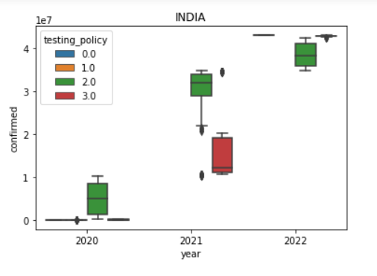
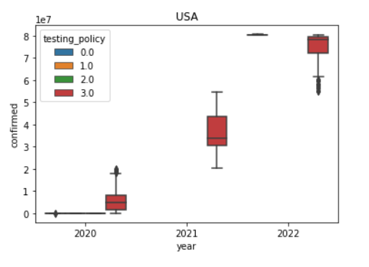
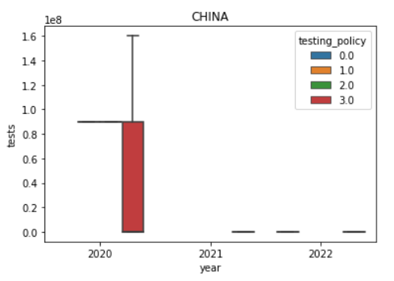
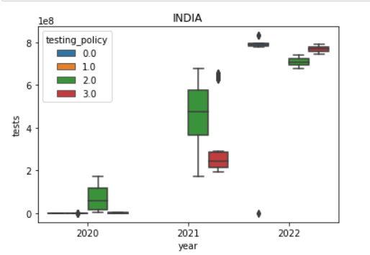
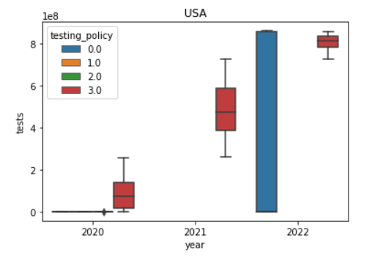
What are the other factors why USA have higher confirmed cases ?
Although from previous slides we concluded that China has least confirmed case compared to INDIA and USA .And USA has highest confirmed case ,but there is one more factor (no of tests).
From the above plot we can see that USA have done higher number of test compared to India and China . This is another factor why USA have higher confirmed cases.

Slide 16
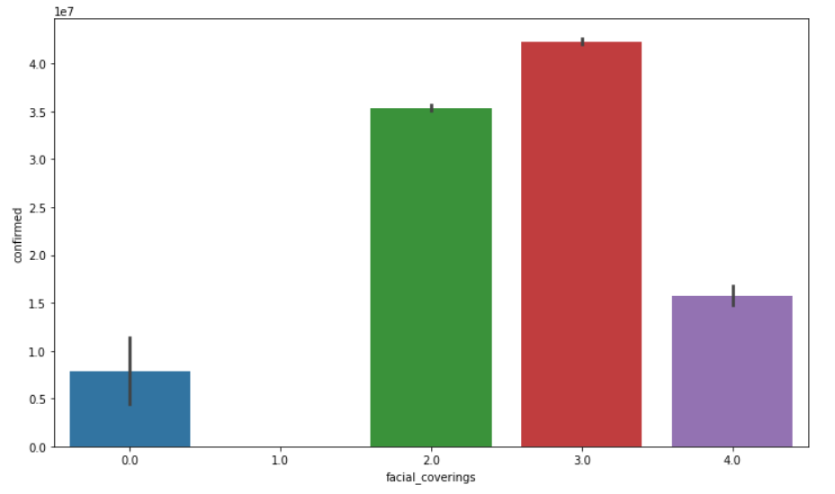
Efficiency of facial coverings (masks)
As we cannot find any trend in the above graph we can conclude that when everyone uses mask strictness(4) we can see decrease in confirmed case .
This measure is less effective compared to other measures

Slide 17
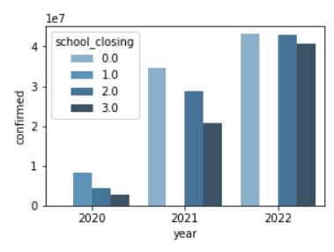
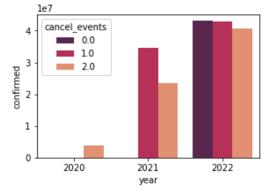
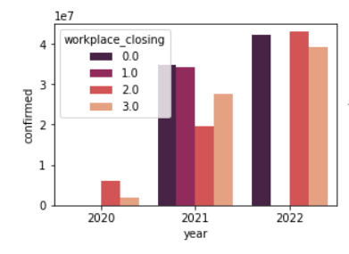
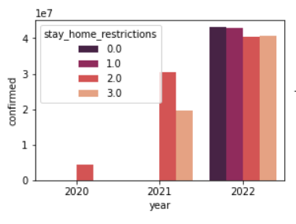
Year wise analysis:
School Closing
Cancel Events
In each year with increasing
school closing
workplace closing
Cancel Events
Stay home restrictions
measures the number of confirmed cases were found
to be decreasing
Workplace closing
Stay home restrictions

Slide 18
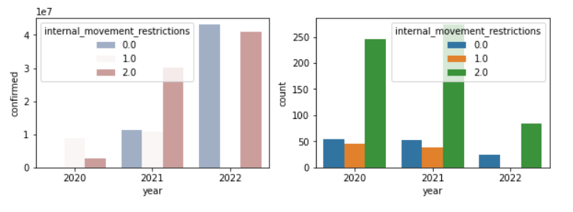
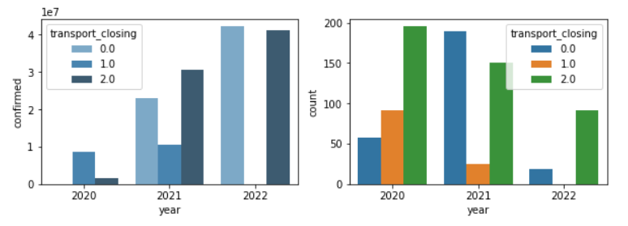
Internal movement restrictions
In each year with increasing Internal movement restrictions and Transport closing measures the number of confirmed cases were found to be increasing because the period for which high measures imposed was long as shown in the count plot.
Transport closing

Slide 19
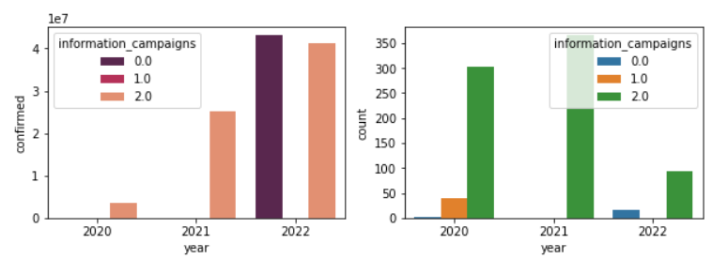
Information campaigns
In each year with increasing Information campaigns measures the number of confirmed cases were found to be increasing because the period for which high measures imposed was long as shown in the count plot.

Slide 20
Conclusion
1.Various Lockdown measures such as
School closing.
Work place closing.
Cancel event.
Transport closing
Stay at home.
International movement restriction.
Creating awareness.
were effective and should be implemented
2.Vaccinations were effective in reducing deaths.
3. Facial covering is not much effective in preventing cases.

